Slide 1

UofSC EE 201 Lab 5, Digital Logic
Hunter Frady
10.12.2022

Slide 2
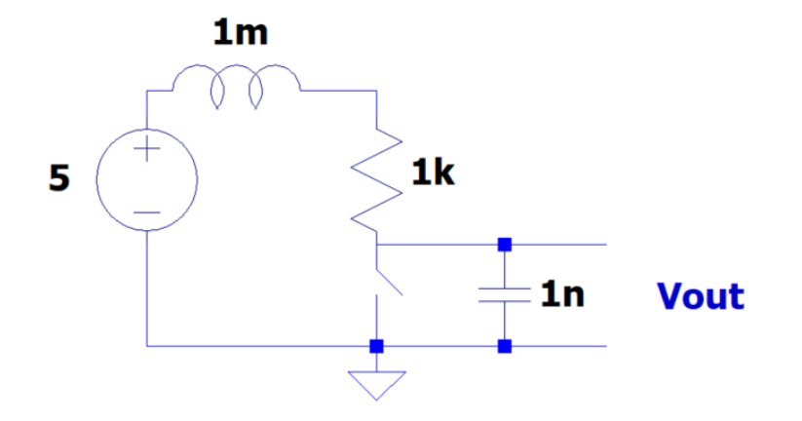
Circuit #1
An RLC circuit with a pushbutton was created to demonstrate the effects of different button resistances.
Resistor Value | Max Voltage
10 | 50
1000 | 6.6
10000 | 5

Slide 3
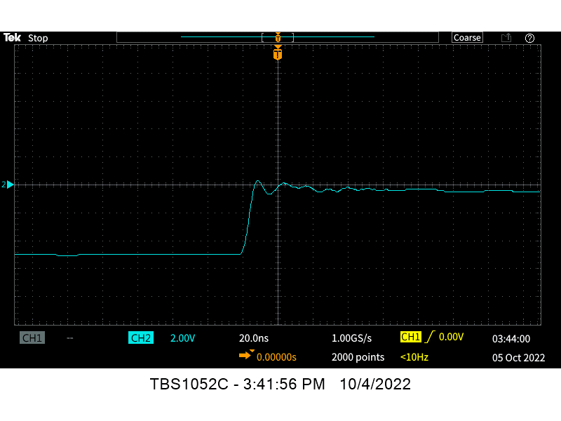
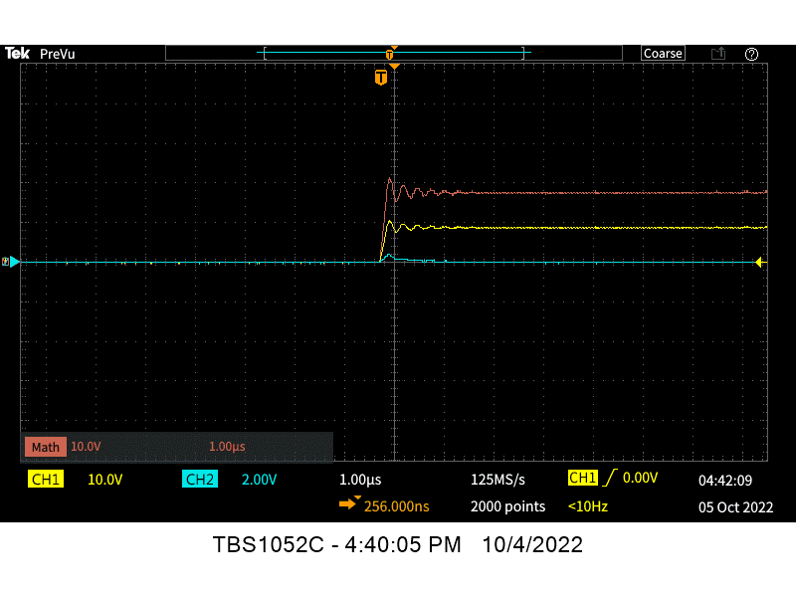
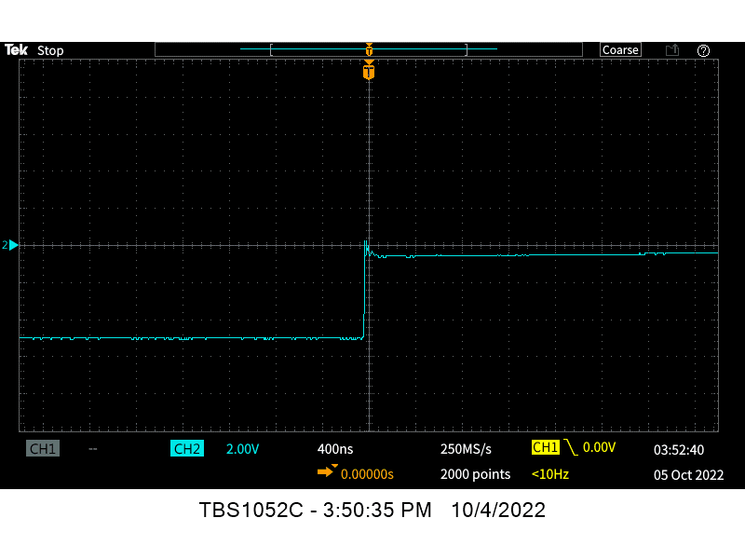
Oscilloscope results from Circuit #1
Oscilloscope images using math function and the damping oscillating circuit.

Slide 4
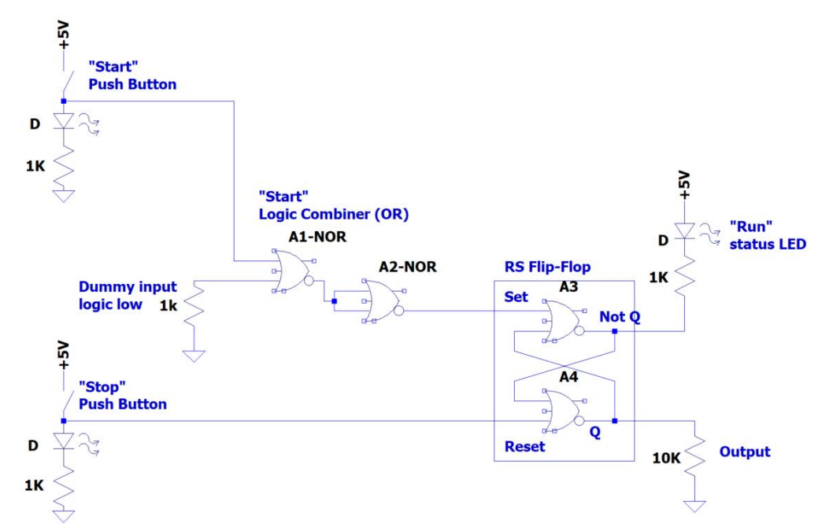
Circuit #2
A flip flop was built to demonstrate how flipflops work. A start and stop pushbutton was used with LEDs as indicators.
A separate LED was used to indicate the state of the flip flop.

Slide 5
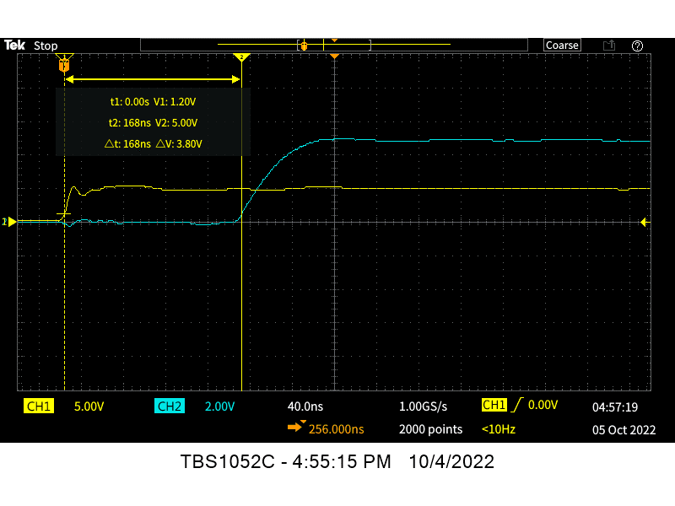
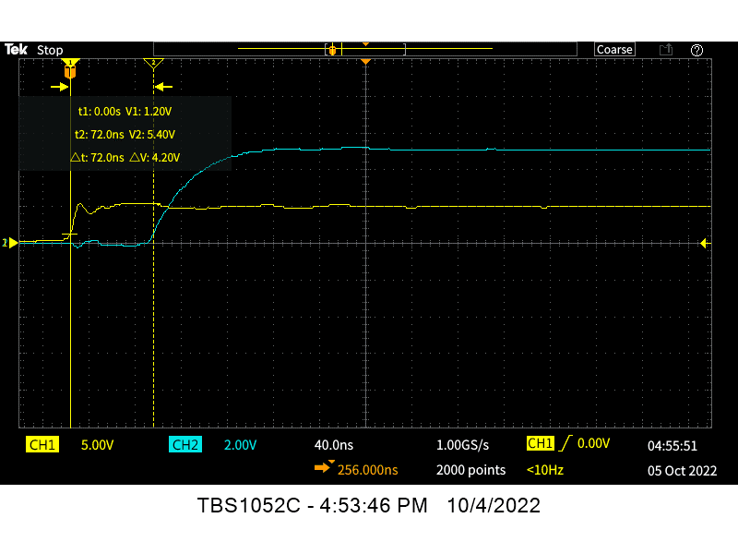
Oscilloscope results from Circuit #2
Oscilloscope images of the delay between pushbutton and the LED turning on and the delay between the first gate and the LED

Slide 6



THANK YOU
Hunter Frady
803-622-3482
Fradyc@email.sc.edu

